Slide 1
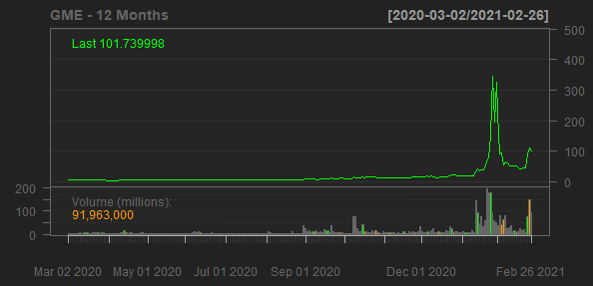
GameStop Corp.
GME
Sector: Consumer Cyclical
Industry: Specialty Retail
GameStop Corp. operates as a multichannel video game, consumer electronics, and collectibles retailer in the United States, Canada, Australia, and Europe. The company sells new and pre-owned video game platforms; accessories, including controllers, gaming headsets, virtual reality products, and memory cards; new and pre-owned video game software; and in-game digital currency, digital downloadable content, and full-game downloads, as well as network points cards, and prepaid digital and prepaid subscription cards. It also sells collectibles comprising licensed merchandise primarily related to the video game, television, and movie industries, as well as pop culture themes. The company operates its stores and e-commerce sites under the GameStop, EB Games, and Micromania brands; and collectibles stores under the Zing Pop Culture and ThinkGeek brand, as well as offers Game Informer, a print and digital video game publication featuring reviews of new title releases, game tips, and news regarding the video game industry. As of February 1, 2020, the company operated 5,509 stores across 14 countries. The company was formerly known as GSC Holdings Corp. GameStop Corp. was founded in 1996 and is headquartered in Grapevine, Texas.
Sales Growth
EBIT Margin
7.31%
6.29%
6%
5.2%
0%
-3.06%
4%
3.75%
Sales Growth
EBIT Margin
-10%
2%
-20%
-21.96%
0.23%
0%
2018-02-03
2019-02-02
2020-02-01
2017-01-28
2018-02-03
2019-02-02
2020-02-01
Date
Date

